Slide 1


Sentimental Analysis of the Market Indexes
Francisco Barreto
Data Analyst – Feb 2022

Slide 2


Index:
Project Description
Hypotheses / Questions
Dataset
Market data
NewsHeadlines
Main DataFrame
Results
Conclusion

Slide 3
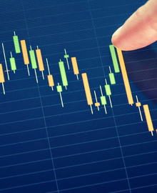
Project Description
Data gathering of the prices/valuation of the main Market indexes
Headlines/ news for each market
Sentimental Analysis

Slide 4

Hypothesis / Question
Is the price impacted by the sentiments of the investors when they see the News Headlines?

Slide 5


Data Set
Is the price impacted by the sentiments of the investors when they see the News Headlines?
TradingView
Google News
TradingView provides latest stock, futures, index, Forex and Bitcoin data in a useful format that works on any device.
Data Retrieved
Price , Tickers , title info and Technical Evaluation
How?
Using Web Scaping and Selenium (https://www.tradingview.com/ )
Google News is a news aggregator service developed by Google. It presents a continuous flow of links to articles organized from thousands of publishers and magazines.
Data Retrieved :
News Headlines and descripitions
How ?
Using the API (https://news.google.com/)

Slide 6
Market Data
Sample of the Principal Stock markets Worldwide
Total of 49 indexes/Markets
 | Ticker
0 | SPXS&P 500 Index
1 | IXICUS Composite Index
2 | DJIDow Jones Industrial Average Index
3 | VIXVolatility S&P 500 IndexD
4 | TSXS&P/TSX Composite Index
5 | UKXUK 100 Index
6 | DAXDAX Index
7 | PX1CAC 40 Index
8 | FTMIBMilano Italia Borsa Index
9 | NI225Nikkei 225 Index
10 | KOSPIKorea Composite Stock Price Index
11 | HSIHang Seng Index
12 | STIStraits Times Index
13 | XJOS&P/ASX 200 Index
14 | NZ50GS&P / NZX 50 Index Gross
15 | TAIEXTaiwan Capitalization Weighted Stock Index
16 | FBMKLCIFTSE Bursa Malaysia KLCI Index
17 | COMPOSITEIDX Composite Index
18 | SX5EEuro Stoxx 50 Index
19 | IBCIBEX 35 Index
20 | SMISwiss Market Index
21 | WIG20WIG20 Index
22 | AEXAEX Index
23 | BEL20BEL 20 Index
24 | IMOEXMOEX Russia Index
25 | OMXH25OMX Helsinki 25 Index
26 | OMXI10OMX ICELAND 10
27 | OMXS30OMX Stockholm 30 Index
28 | OMXC25OMX Copenhagen 25 Index
29 | BELEX15BELEX 15 IndexD
30 | OMXRGIOMX Riga GI
31 | OMXTGIOMX Tallinn GI
32 | OMXVGIOMX Vilnius GI
33 | XU100BIST 100 Index
34 | TA35TA-35 Index
35 | SA40South Africa Top 40 Index
36 | NIFTYNifty 50 Index
37 | SENSEXS&P BSE Sensex Index
38 | DFMGIDFM Index
39 | TASITadawul All Shares Index
40 | GNRIQE Index
41 | BHBXBAHRAIN ALL SHARE INDEX
42 | EGX30EGX 30 Price Return Index
43 | IBOVIBovespa Index
44 | MEIPC Mexico Index
45 | IMVMERVAL Index
46 | ICAPINDICE DE CAPITALIZACION BURSATIL
47 | SP_IPSAS&P IPSA
48 | SPBLPGPTS&P / BVL Peru General Index (PEN)

Slide 7

Market Data
Sample of the Principal Stock markets Worldwide
Total of 49 indexes/Markets
Ticker – Market/Title identification
Last price – Last bid price
Chng – variation between the last registered bid price
Chng % - variation in % regarding the last bid price
High – Highest bid price registered
Low – lowest bid price registered
Techinal Rating – Qualiatitve classification provided by trading views
 | Ticker | Last Price | Chg % | Chg | High | Low | Technical Rating
0 | SPXS&P 500 Index | 4224.46 | 1.18% | 49.25 | 4240.71 | 4162.9 | Sell
1 | IXICUS Composite Index | 12618.59 | 1.02% | 127.85 | 12703.79 | 12430.9 | Sell
2 | DJIDow Jones Industrial Average Index | 33584.48 | 1.04% | 344.29 | 33697.18 | 33108.89 | Sell
3 | VIXVolatility S&P 500 IndexD | 30.04 | −10.38% | −3.48 | 32.77 | 29.82 | Buy
4 | TSXS&P/TSX Composite Index | 20812.14 | 0.59% | 121.33 | 20855.48 | 20619.32 | Sell
5 | UKXUK 100 Index | 7425.62 | 0.53% | 39.42 | 7458.24 | 7344.89 | Sell
6 | DAXDAX Index | 13793.94 | 0.27% | 37.54 | 13849.43 | 13566.2 | Sell
7 | PX1CAC 40 Index | 6445.26 | 0.48% | 30.69 | 6474.96 | 6338.61 | Sell
8 | FTMIBMilano Italia Borsa Index | 23830.12 | 0.63% | 148.37 | 23887.14 | 23304.27 | Sell
General Satistics | Last | High | Low
count | 49.000000 | 49.000000 | 49.000000
mean | 15011.243727 | 15091.974816 | 14854.791308
std | 22812.834537 | 22950.580439 | 22581.812673
min | 30.040000 | 32.770000 | 29.820000
25% | 2048.687000 | 2061.375000 | 2038.116000
50% | 6445.260000 | 6474.960000 | 6338.610000
75% | 16303.350000 | 16427.320000 | 16219.410000
max | 109399.820000 | 110107.480000 | 108214.130000

Slide 8
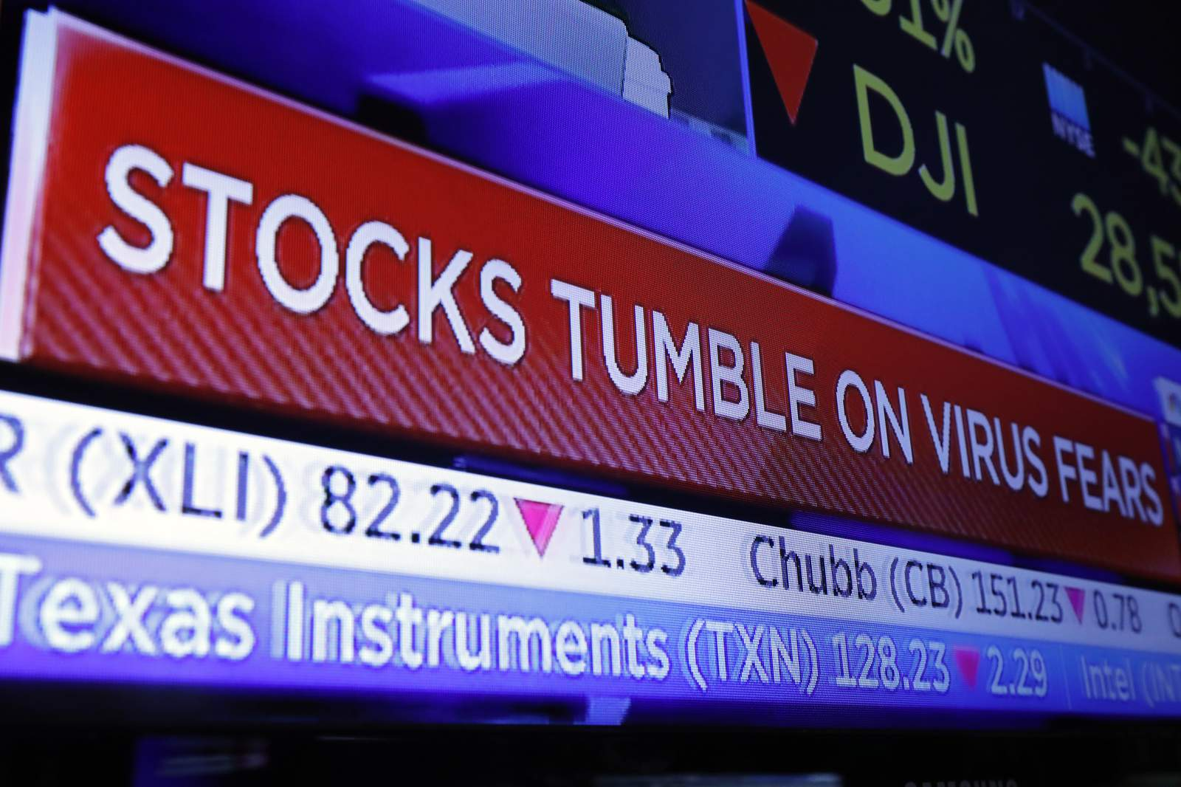
News Data
News Headlines of Principal Stock Markets Worldwide
Total of 4417 records
 | Title | Media | Date | Datetime | Desc | Link | Ticker
0 | Elon Musk and Twitter News: Live Updates | The New York Times | LIVE17 mins ago | 27/08/202 | Musk may be about to sell some Tesla stock. How would that affect markets? Image. Tesla's volatile stock is one of the most influential components of the... | https://www.nytimes.com/live/2022/04/27/technology/twitter-elon-musk-news | S&P 500 Index
1 | Wall Street: Nasdaq 100, S&P 500 and Dow 30 fall more than 2% with top stocks ending 5% lower | The Financial Express | 1 hour ago | 27/08/202 | Inflationary data leading to rising yields, increasing concern of Covid-19 in China, ongoing war in Ukraine and the fear of it spreading any further are... | https://www.financialexpress.com/investing-abroad/featured-stories/wall-street-nasdaq-100-sp-500-and-dow-30-fall-more-than-2-with-top-stocks-ending-5-lower/2505074/ | S&P 500 Index
2 | S&P 500 Forecast: Index Continues to Look Sick | DailyForex.com | 3 hours ago | 27/08/202 | The S&P 500 fell significantly on Tuesday as we continue to see a lot of negativity in the markets. | https://www.dailyforex.com/forex-technical-analysis/2022/04/sp-500-forecast-index-continues-to-look-sick-april-27-2022/177989 | S&P 500 Index
Title – News headline
Date – time in hours/minutes of the data collection
Datetime- Date of the article
Desc – Article summary
Link- link to the article newspaper
Ticker – Market/Title identification

Slide 9
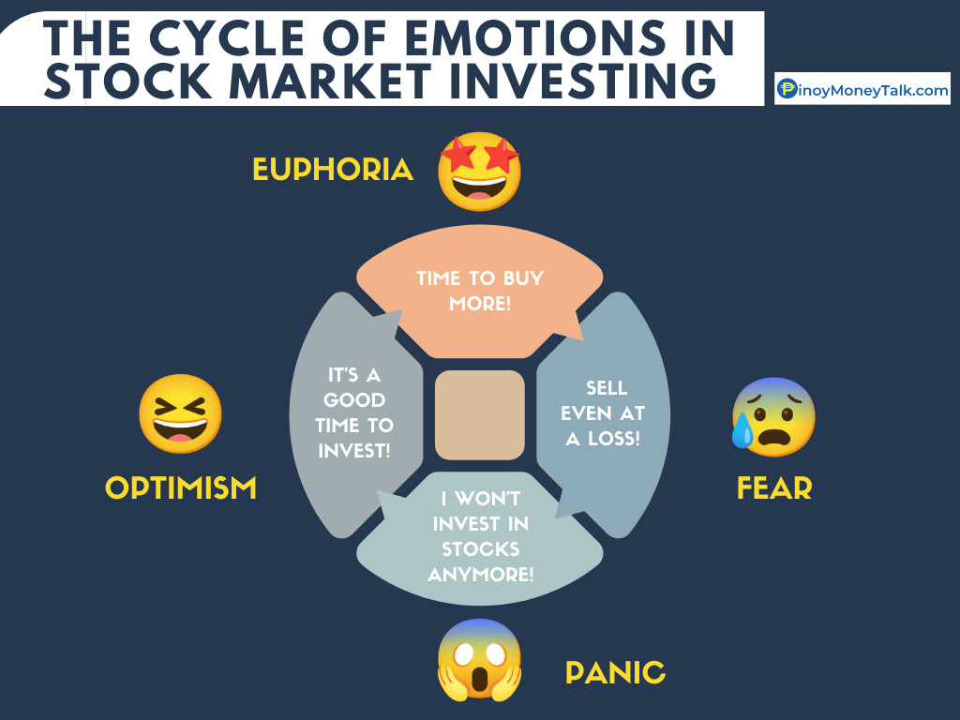
Results
Methodology
Obtain the Data Sets Market_Data & News_Headlines
Perfom a Sentimental Analysis of the News_Headlines using the library TextBlob
Obtain sentiment Polarity range [-1,1]
Average of sentiment Polarity by Ticker
Compare with the Technical Rating

Slide 10
Results
Combination of 2 Datasets
Ticker | Sentiment
AEX Index | 0.15
BAHRAIN ALL SHARE INDEX | 0.145
BEL 20 Index | 0.002222
BELEX 15 Index | 0.038889
BIST 100 Index | 0.00875
CAC 40 Index | 0.1
DAX Index | -0.01681
DFM Index | 0.054815
Dow Jones Industrial Average Index | 0.075101
EGX 30 Price Return Index | -0.045
Euro Stoxx 50 Index | 0.09375
 | Ticker_names | Last | Chg % | Chg | Technical rating | Score_rating
0 | S&P 500 Index | 4224.46 | 1.18% | 49.25 | Sell | -1
1 | US Composite Index | 12618.59 | 1.02% | 127.85 | Sell | -1
2 | Dow Jones Industrial Average Index | 33584.48 | 1.04% | 344.29 | Sell | -1
3 | Volatility S&P 500 Index | 30.04 | −10.38% | −3.48 | Buy | 1
4 | S&P/TSX Composite Index | 20812.14 | 0.59% | 121.33 | Sell | -1
5 | UK 100 Index | 7425.62 | 0.53% | 39.42 | Sell | -1
6 | DAX Index | 13793.94 | 0.27% | 37.54 | Sell | -1
7 | CAC 40 Index | 6445.26 | 0.48% | 30.69 | Sell | -1
8 | Milano Italia Borsa Index | 23830.12 | 0.63% | 148.37 | Sell | -1
9 | Nikkei 225 Index | 26386.41 | −1.17% | −313.63 | Strong Sell | -2
10 | Korea Composite Stock Price Index | 2639.07 | −1.10% | −29.25 | Strong Sell | -2

Slide 11
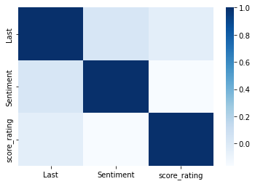



Results
DataFrame
 | Ticker_names | Last | Chg % | Chg | Technical rating | Sentiment | Score_rating
0 | S&P 500 Index | 4224.46 | 1.18% | 49.25 | Sell | 0.018344 | -1
1 | US Composite Index | 12618.59 | 1.02% | 127.85 | Sell | 0.045972 | -1
2 | Dow Jones Industrial Average Index | 33584.48 | 1.04% | 344.29 | Sell | 0.075101 | -1
3 | Volatility S&P 500 Index | 30.04 | −10.38% | −3.48 | Buy | -0.03 | 1
4 | S&P/TSX Composite Index | 20812.14 | 0.59% | 121.33 | Sell | -0.0657 | -1
5 | UK 100 Index | 7425.62 | 0.53% | 39.42 | Sell | 0.159773 | -1
6 | DAX Index | 13793.94 | 0.27% | 37.54 | Sell | -0.01681 | -1
7 | CAC 40 Index | 6445.26 | 0.48% | 30.69 | Sell | 0.1 | -1
8 | Milano Italia Borsa Index | 23830.12 | 0.63% | 148.37 | Sell | 0.071364 | -1
9 | Nikkei 225 Index | 26386.41 | −1.17% | −313.63 | Strong Sell | 0.068056 | -2
10 | Korea Composite Stock Price Index | 2639.07 | −1.10% | −29.25 | Strong Sell | 0.147315 | -2
Score_rating : Labels
Strong Sell | -2
Sell | -1
Neutral | 0
Buy | 1
Score_rating conversion - legend
Correlation Matrix

Slide 12

To Conclude:
1:The Price is positively impacted by the investor sentiment
2: The score rating is negatively correlated by the sentiment
Good Feelings -> Buy & Bad Feelings -> Sell
Despite this correlation and the impact in the price of both variables (sentiment and Score rating) on the Overall we can conclude that impact in the price is not that significant

Slide 13

Thank You.
FB
Francisco Barreto

